Slide 1
Case Study 2: Employee Attrition DS6306-Doing Data Science
Hao Wang
December 2019
YouTube: https://youtu.be/akFRgl3ZXJs
Rshiny App: https://data-science-hw.shinyapps.io/EmployeeShiny/
GitHub website: https://48120778.github.io/

Slide 2
TASK 1:
Dataset: CaseStudy2-data.csv
Identify the top three factors that contribute to turnover (backed up by evidence provided by analysis). There may or may not be a need to create derived attributes/variables/features.
Provide any job role specific trends that may exist in the data set (e.g., “Data Scientists have the highest job satisfaction”).
Provide any other interesting trends and observations from your analysis. The analysis should be backed up by robust experimentation and appropriate visualization.

Slide 3
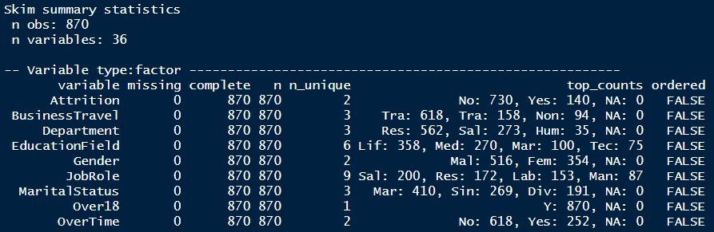
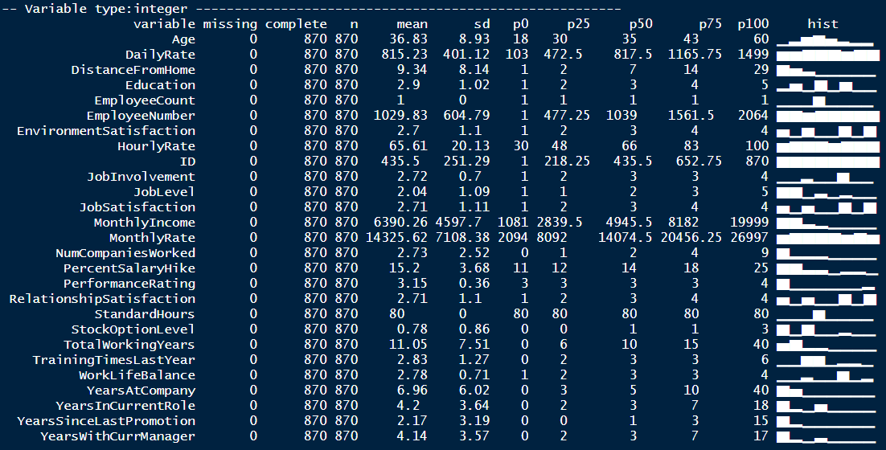
Data Profile
Data Summary
Observation: 870
Variables: 36
Categorical: 9
Numeric: 27
Some variables are not helpful in building the model:
Variables with single value:
EmployeeCount ( All ‘1’ )
Over18 ( All ‘1’ )
StandardHours ( All ‘80’ )
Variables no value:
Id
EmployeeNumber
No missing values

Slide 4
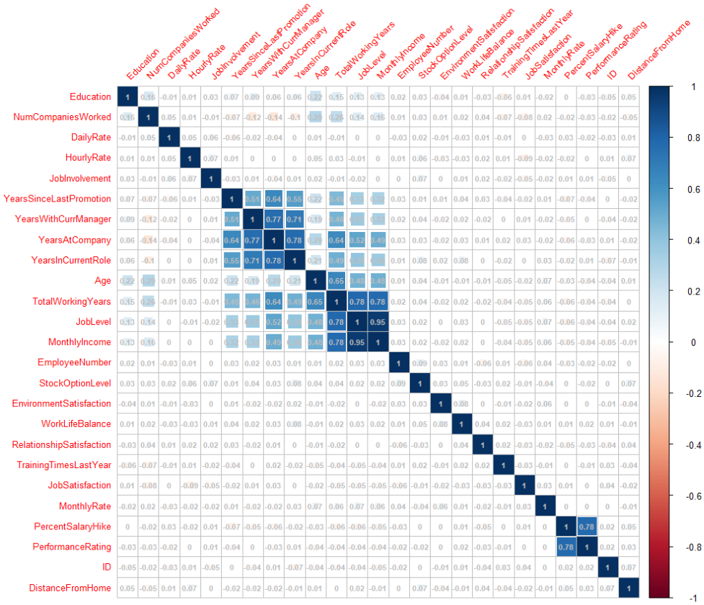
Correlation Check on 24 Numeric Variables
Correlation Results (> 0.60)
0.95 MonthlyIncome vs. JobLevel
0.78 TotalWorkingYears vs. JobLevel
0.78 TotalWorkingYears vs. MonthlyIncome
0.78 YearAtCompany vs. YearInCurrentRole
0.78 PercentSalaryHike vs. PerformanceRating
0.77 YearAtCompany vs. YearWithCurrManager
0.71 YearInCurrentRole vs. YearWithCurrManager
0.65 TotalWorkingYears vs. Age
0.64 YearAtCompany vs. TotalWorkingYears
0.64 YearAtCompany vs. YearsSinceLastPromotion
Variables that have high correlation with one another won’t be eliminated following project advice, to keep the information which may be correlated with the response individually.

Slide 5
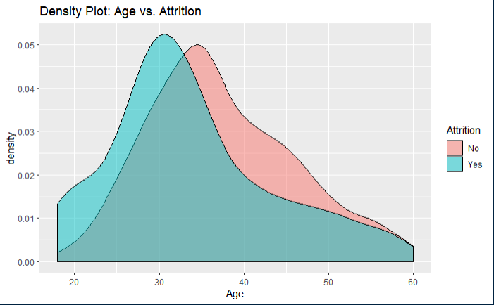
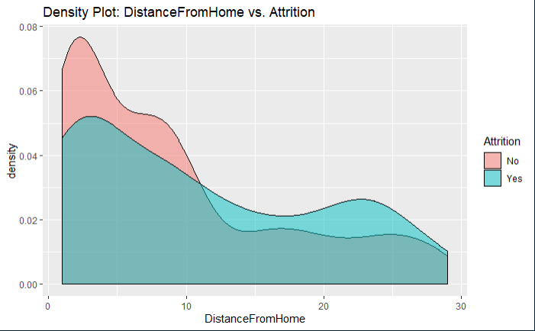
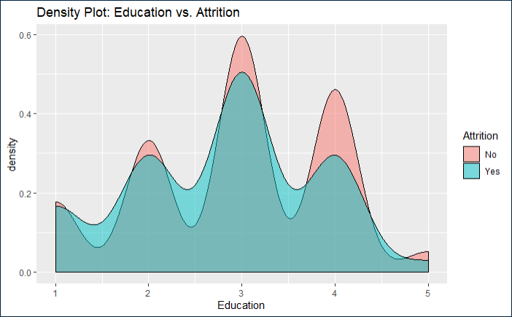
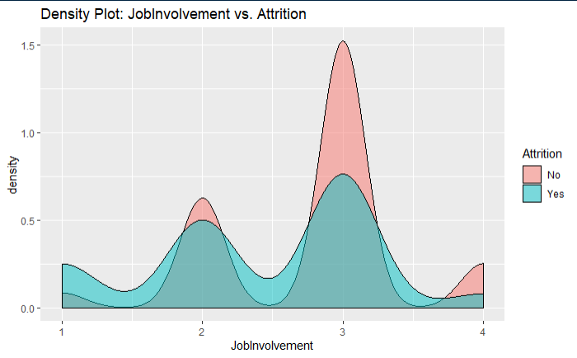
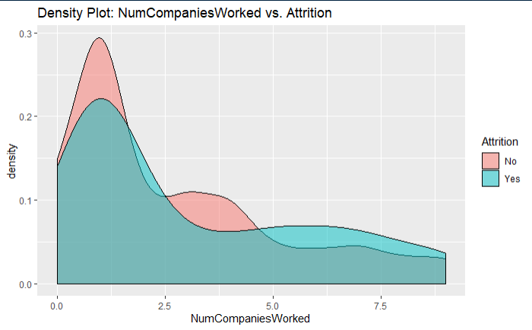
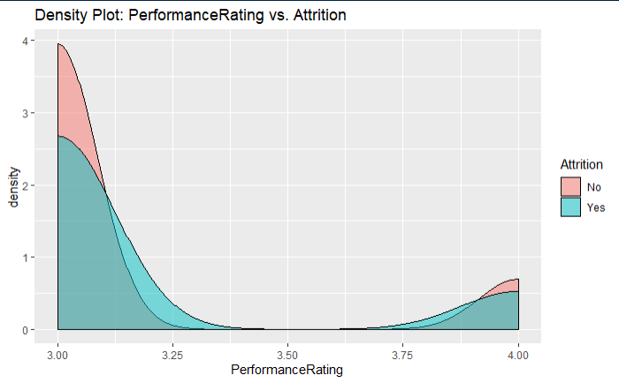
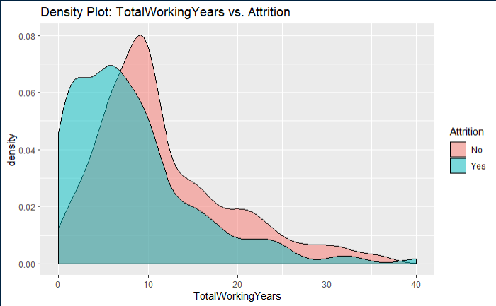
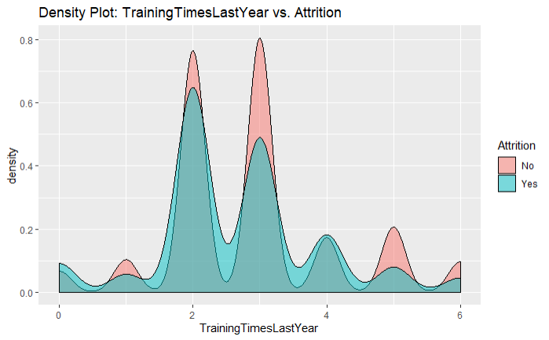
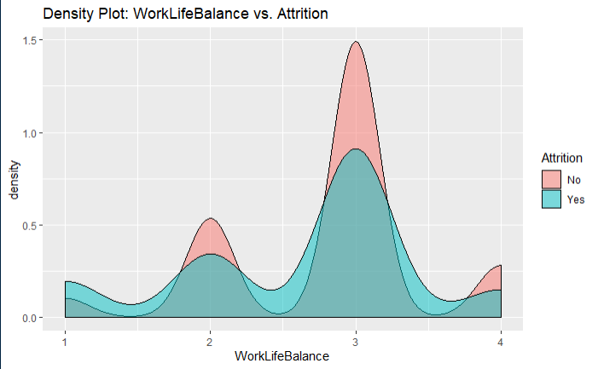
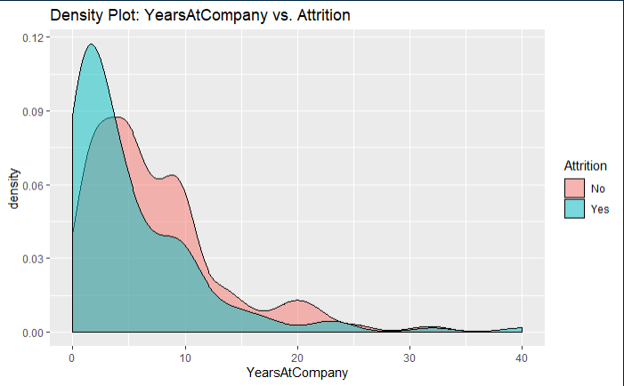
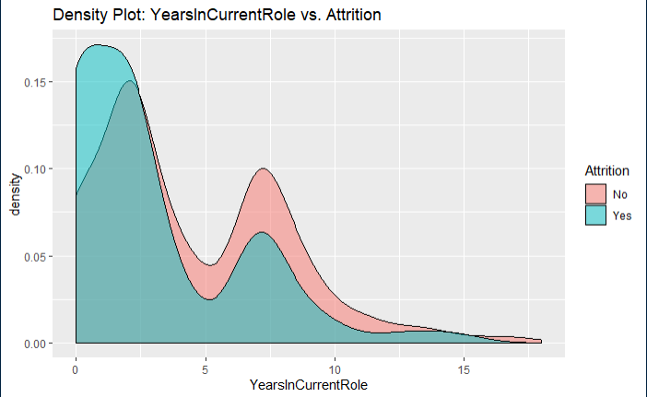
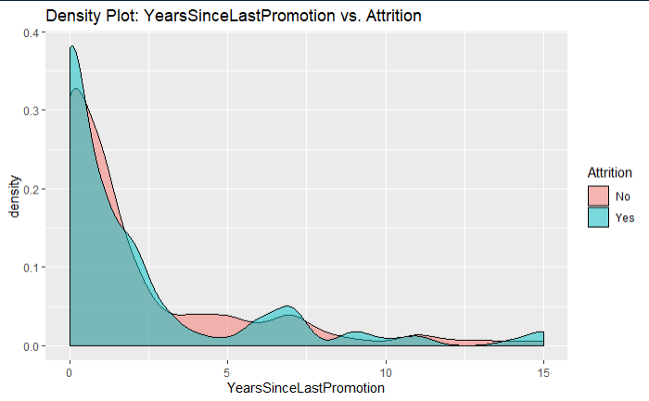
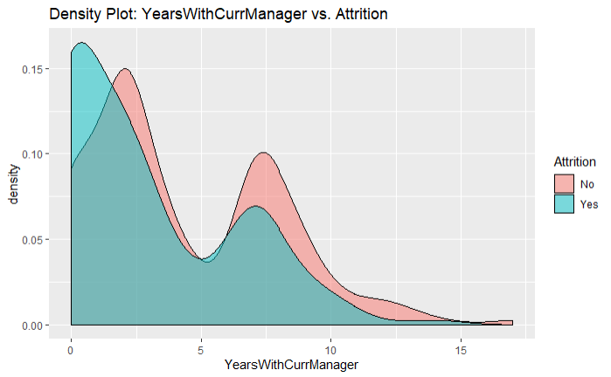
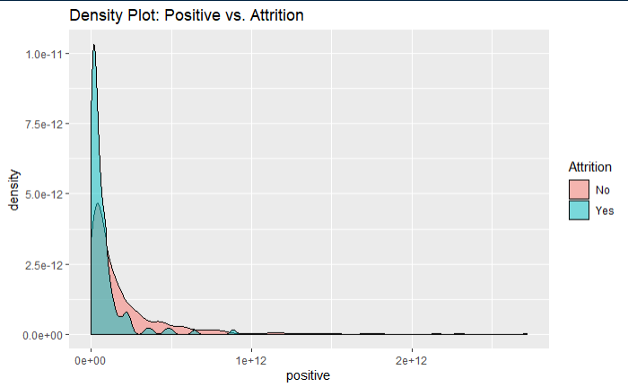
Density Plots for Predictor Selection
2 Age
7 DistanceFromHome
8 Education
15 JobInvolvement
22 NumCompaniesWorked
26 PerformanceRating
30 TotalWorkingYears
31 TrainingTimesLastYear
32 WorkLifeBalance
33 YearsAtCompany
34 YearsInCurrentRole
35 YearsSinceLastPromotion
36 YearsWithCurrManager
38 Positive
Density plots indicate the attrition rate overlapping between ‘Yes’ or ‘No’

Slide 6
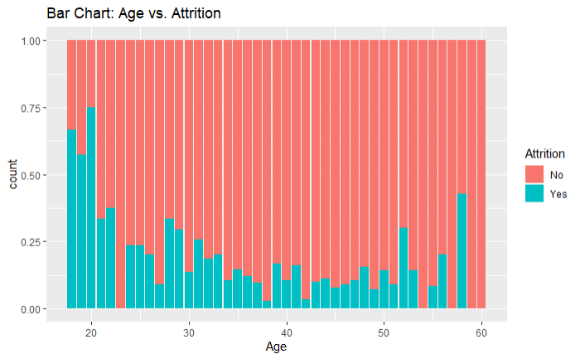
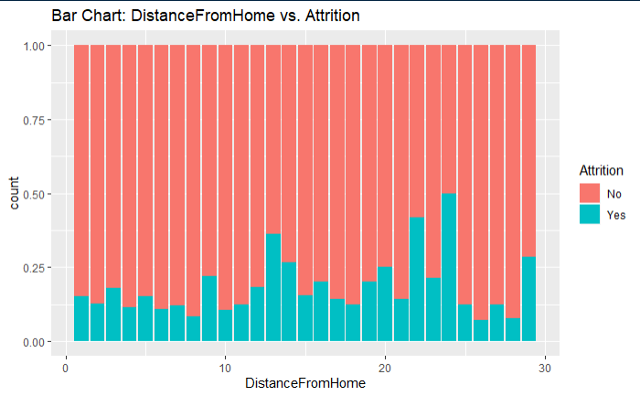
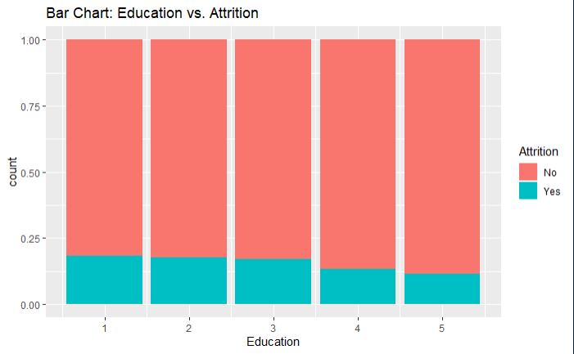
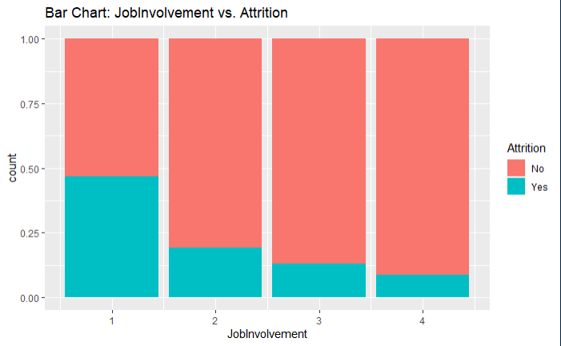
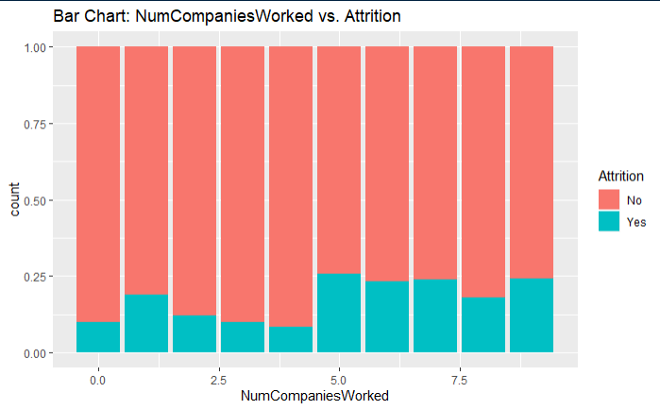
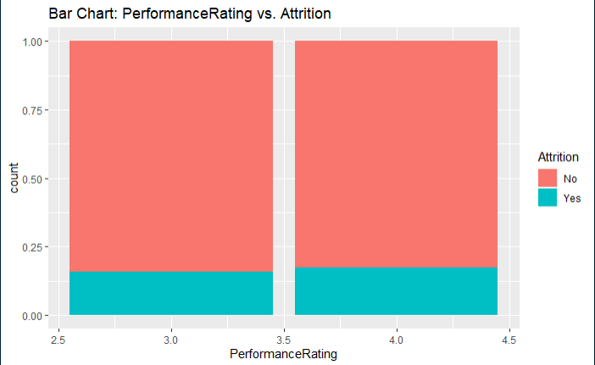
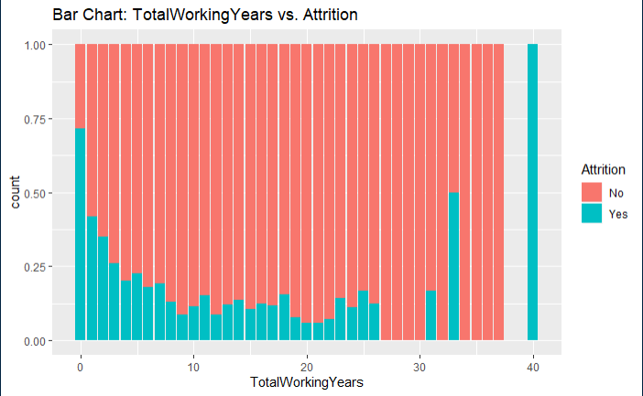
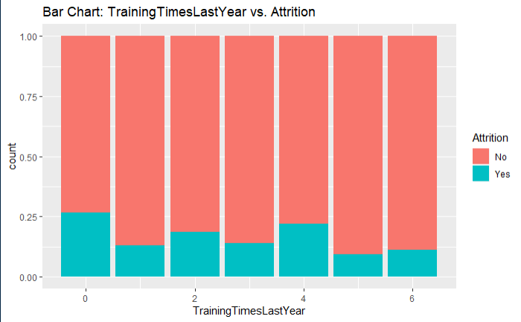
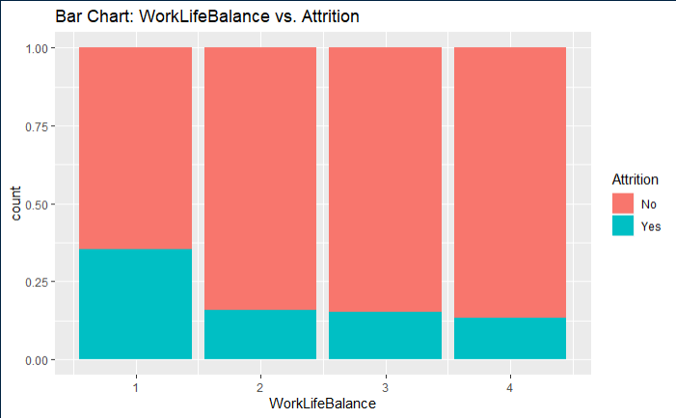
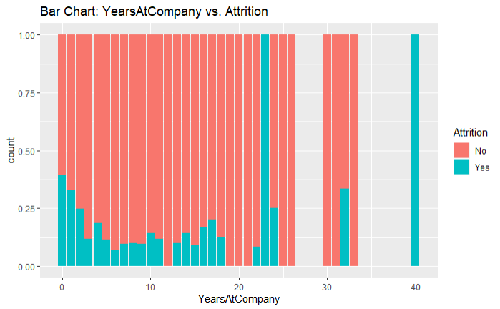
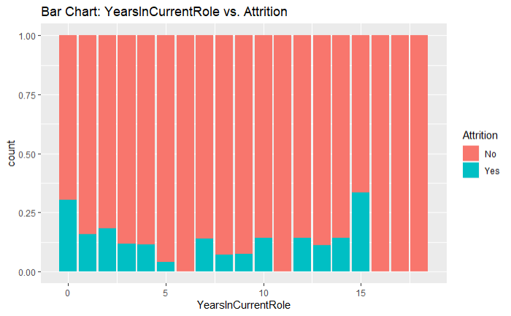
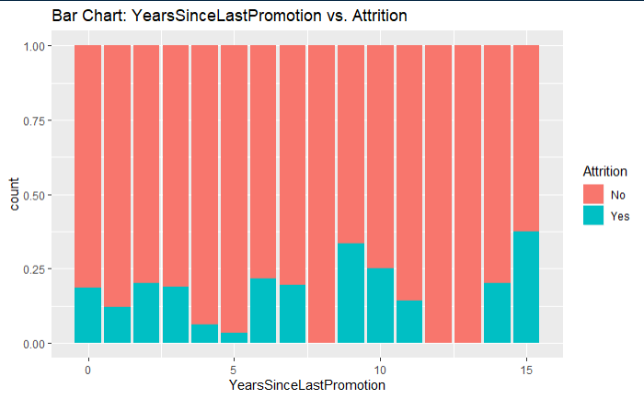
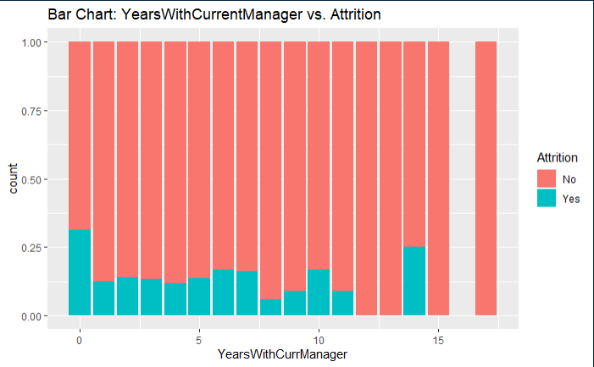
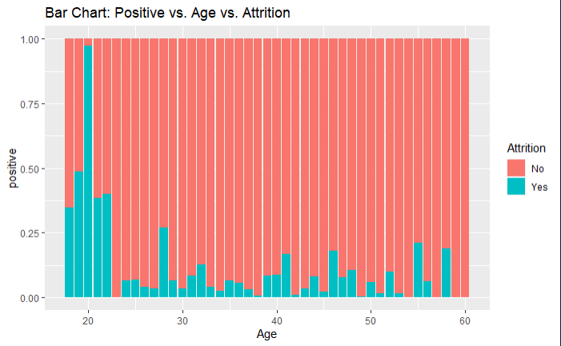
Bar Charts for Predictor Selection
2 Age
7 DistanceFromHome
8 Education
15 JobInvolvement
22 NumCompaniesWorked
26 PerformanceRating
30 TotalWorkingYears
31 TrainingTimesLastYear
32 WorkLifeBalance
33 YearsAtCompany
34 YearsInCurrentRole
35 YearsSinceLastPromotion
36 YearsWithCurrManager
38 Positive
Bar charts indicate the attrition rate ‘Yes’ has a relatively random distribution against these variables

Slide 7
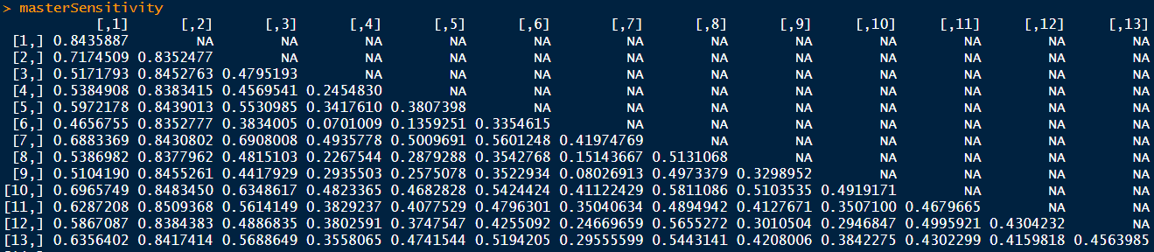
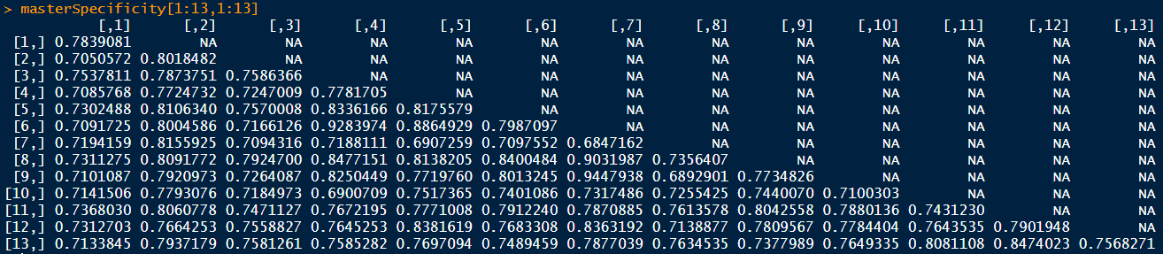
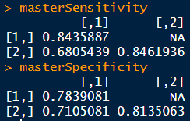
KNN Model 1
Initial KNN model indicates imbalanced class data in train set, which resulted in higher sensitivity like 85% and lower specificity like 15%
Over-sampling technique has been used to create balanced data for model build
For loop is used to find the best sensitivity and specificity with over-sampling data, using 2 predictors from significantID <- c(2,38,7,8,15,22,26,30,31,32,33,34,35,36)

Slide 8
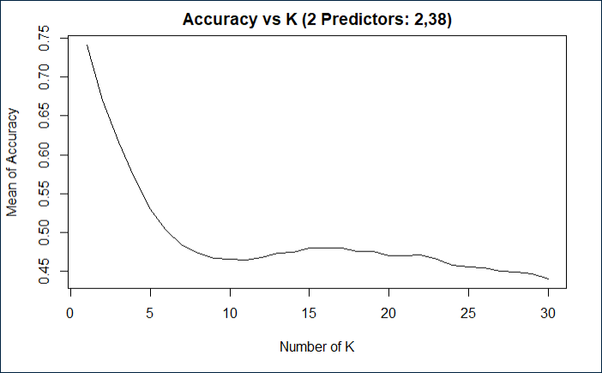
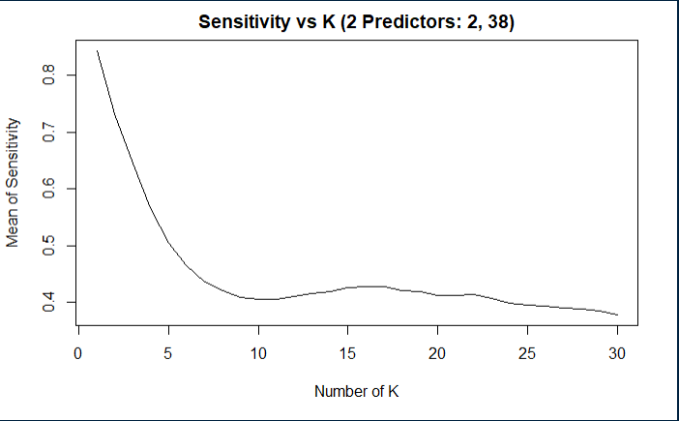

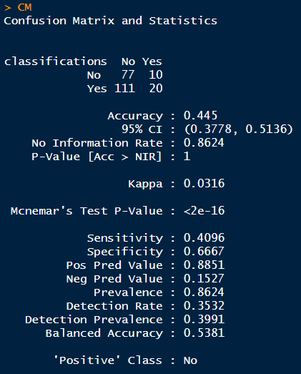
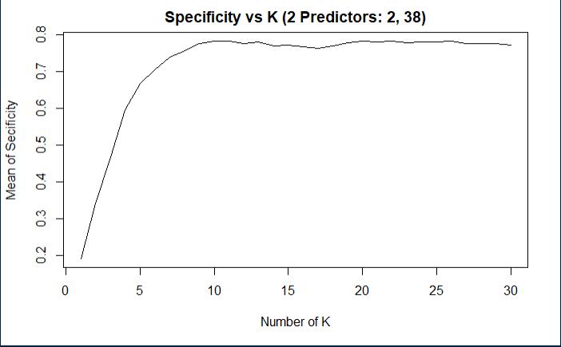
KNN Model 2
Build KNN model with over-sampling data, 2 predictors (Age, Positive)
significantID <- c(2,38)
Predictor 2: Age
Predictor 38: Positive
positive = as.numeric(DailyRate)
* HourlyRate
* MonthlyIncome
* PercentSalaryHike
* (StockOptionLevel+1)
* EnvironmentSatisfaction
* JobSatisfaction
* RelationshipSatisfaction

Slide 9
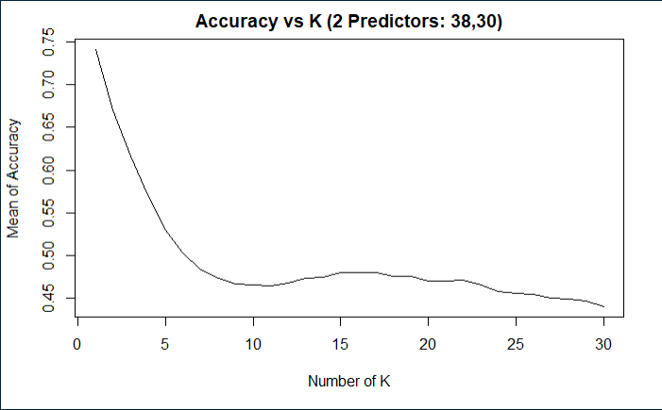
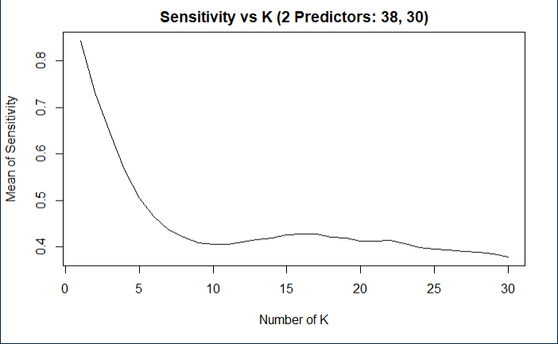
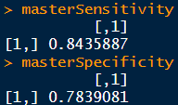
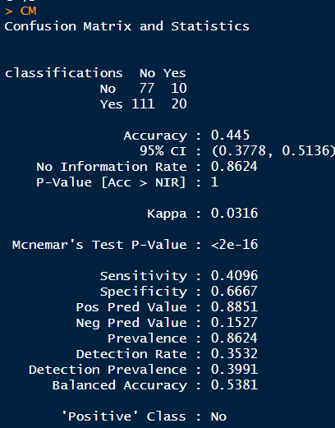
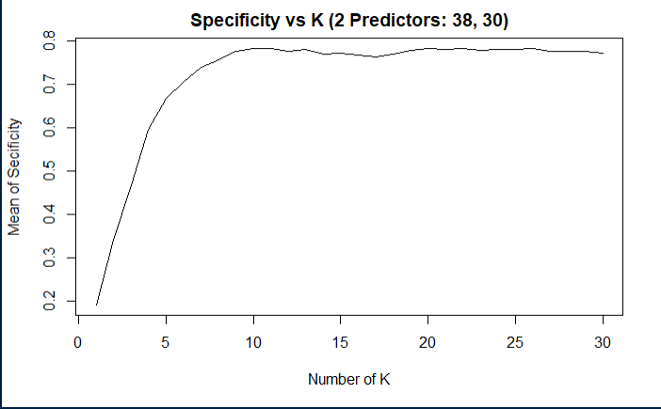
KNN Model 3
Build KNN model the 3rd time, with over-sampling data, 2 predictors (Positive, TotalWorkingYears)
significantID <- c(38,30)
Predictor 30: TotalWorkingYears
Predictor 38: Positive
positive = as.numeric(DailyRate)
* HourlyRate
* MonthlyIncome
* PercentSalaryHike
* (StockOptionLevel+1)
* EnvironmentSatisfaction
* JobSatisfaction
* RelationshipSatisfaction

Slide 10
KNN Model Summary
Only numeric variables can be used as predictors in KNN model.
KNN model can provide high sensitivity or high specificity separately, with different K
Changing seed number or split percentage would throw impact on sensitivity / specificity as well
With specific seed number and split percentage, KNN model can meet project requirements of 60%+ on both sensitivity and specificity on test set. However the same model can’t achieve that accurate prediction results if we change to use a new test set.
A more robust model need to be created for better prediction.

Slide 11
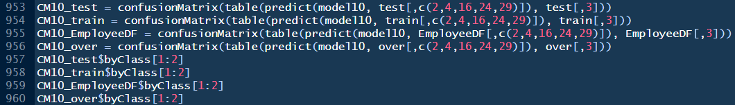
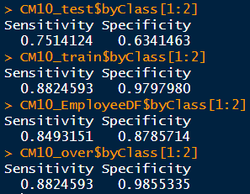
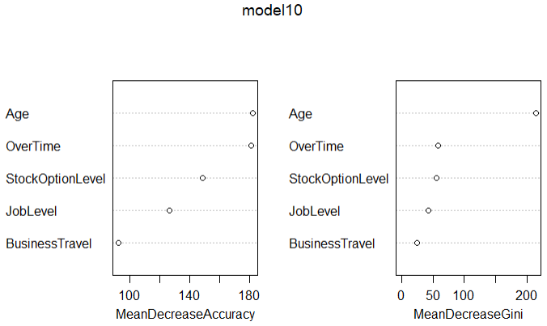
Random Forest Model
Build random forest model, with over-sampling data, 5 predictors (2,4,16,24,29)
Top 3 factors that contribute to turnover
Random Forest Model
75% sensitivity and 63.4% specificity achieved on test set the same time
88% / 98% on train set
85% / 88% on original whole set (train + test)
Both numeric and categorical variables can be used in Random Forest Model as predictors.
Predictor list:
Age
BusinessTravel
JobLevel
OverTime
StockOptionLevel

Slide 12
TASK 2:
Dataset: CaseStudy2CompSet No Attrition.csv
Provide a model that will attain at least 60% sensitivity and specificity (60 each = 120 total) for the training and the validation set, provide the labels (ordered by ID) in a csv file.
Include this in your GitHub repository and call the file “Case2PredictionsWang Attrition.csv”.

Slide 13
TASK 3:
Dataset: CaseStudy2CompSet No Salary.csv
Provide a model that will attain a RMSE < $3000 for the training and the validation set, provide the predicted salaries (ordered by ID) in a csv file.
Include this in your GitHub repository and call the file “Case2PredictionsWang Salary.csv”.

Slide 14
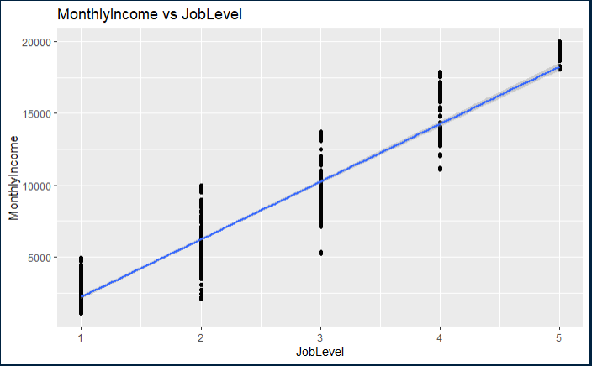
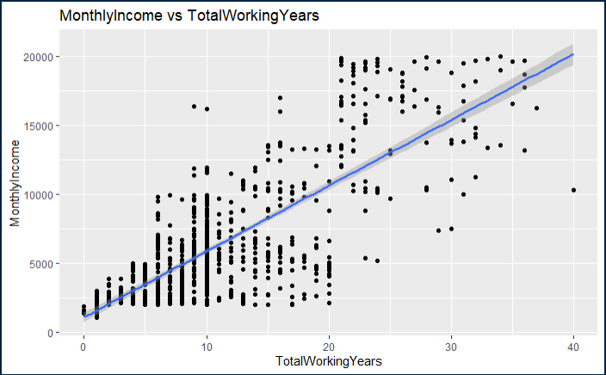
Check Correlation
Correlation with MonthlyIncome (>0.50)
0.95 MonthlyIncome vs. JobLevel
0.78 MonthlyIncome vs. TotalWorkingYears

Slide 15
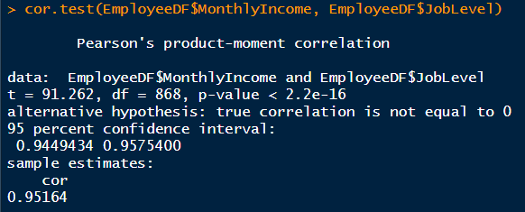
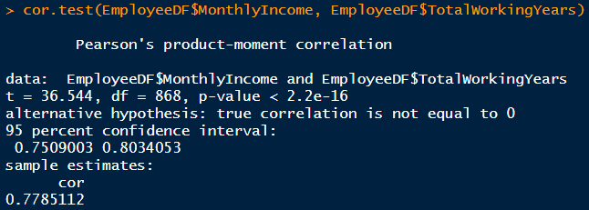
Correlation Test

Slide 16

Prediction Model for MonthlyIncome

Slide 17
Deliverables:
Create a GitHub repository named CaseStudy2DDS.
Rmarkdown file containing
Executive summary
Introduction to the project
All supporting code and analysis
Link to the YouTube video
Slides for presentation
Prediction csv file
Submit a link to the GitHub repository via the space provided for the Case Study 02 page in 2DS.
Put the link to the YouTube video on the Google Doc.
Create an RShiny App to help visualize you results
Create a Knit file out of your RMD and display it on your GitHub Site you created in Unit 12. Include the link to your YouTube video (and a link to your RShiny app too if there is one!)

Slide 18
Rubric:
30% RMarkdown File
30% Final Video Presentation (15% slide content, 15% presentation)
Labeled Plots
7-minute time limit
Correct interpretation
Complete analysis (Adding p-values and conducting tests where appropriate. Have a good handle on at least t-tests, KNN and Naïve Bayes classification and KNN and linear regression to this point)
10% Validation Requirement for Attrition(Sensitivity > 60% and Specificity > 60%)
10% Validation Requirement for Salary(RMSE < $3000)
10% Creativity and completeness in presentation and analysis.
10% Knit RMD and YouTube link on a tab on your GitHub Site.

